Slide 1
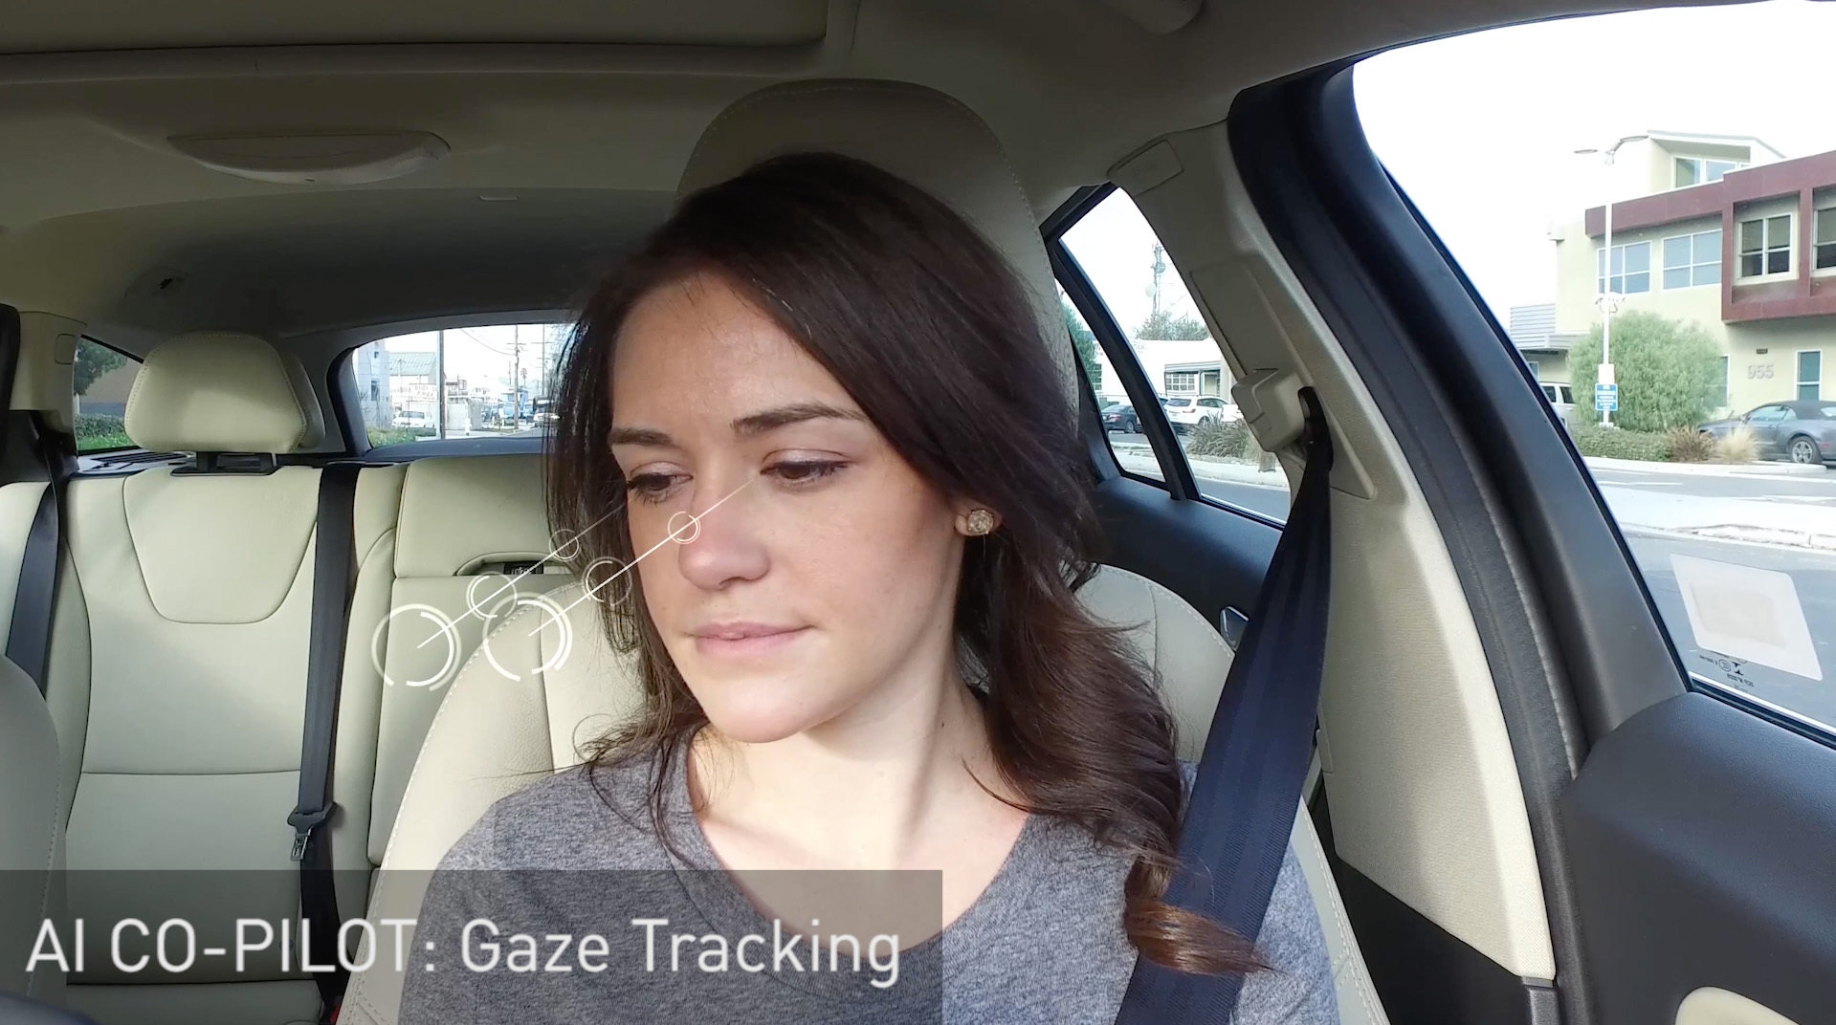
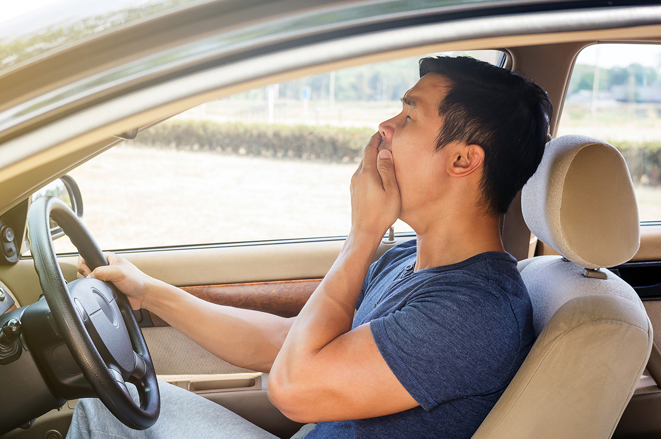
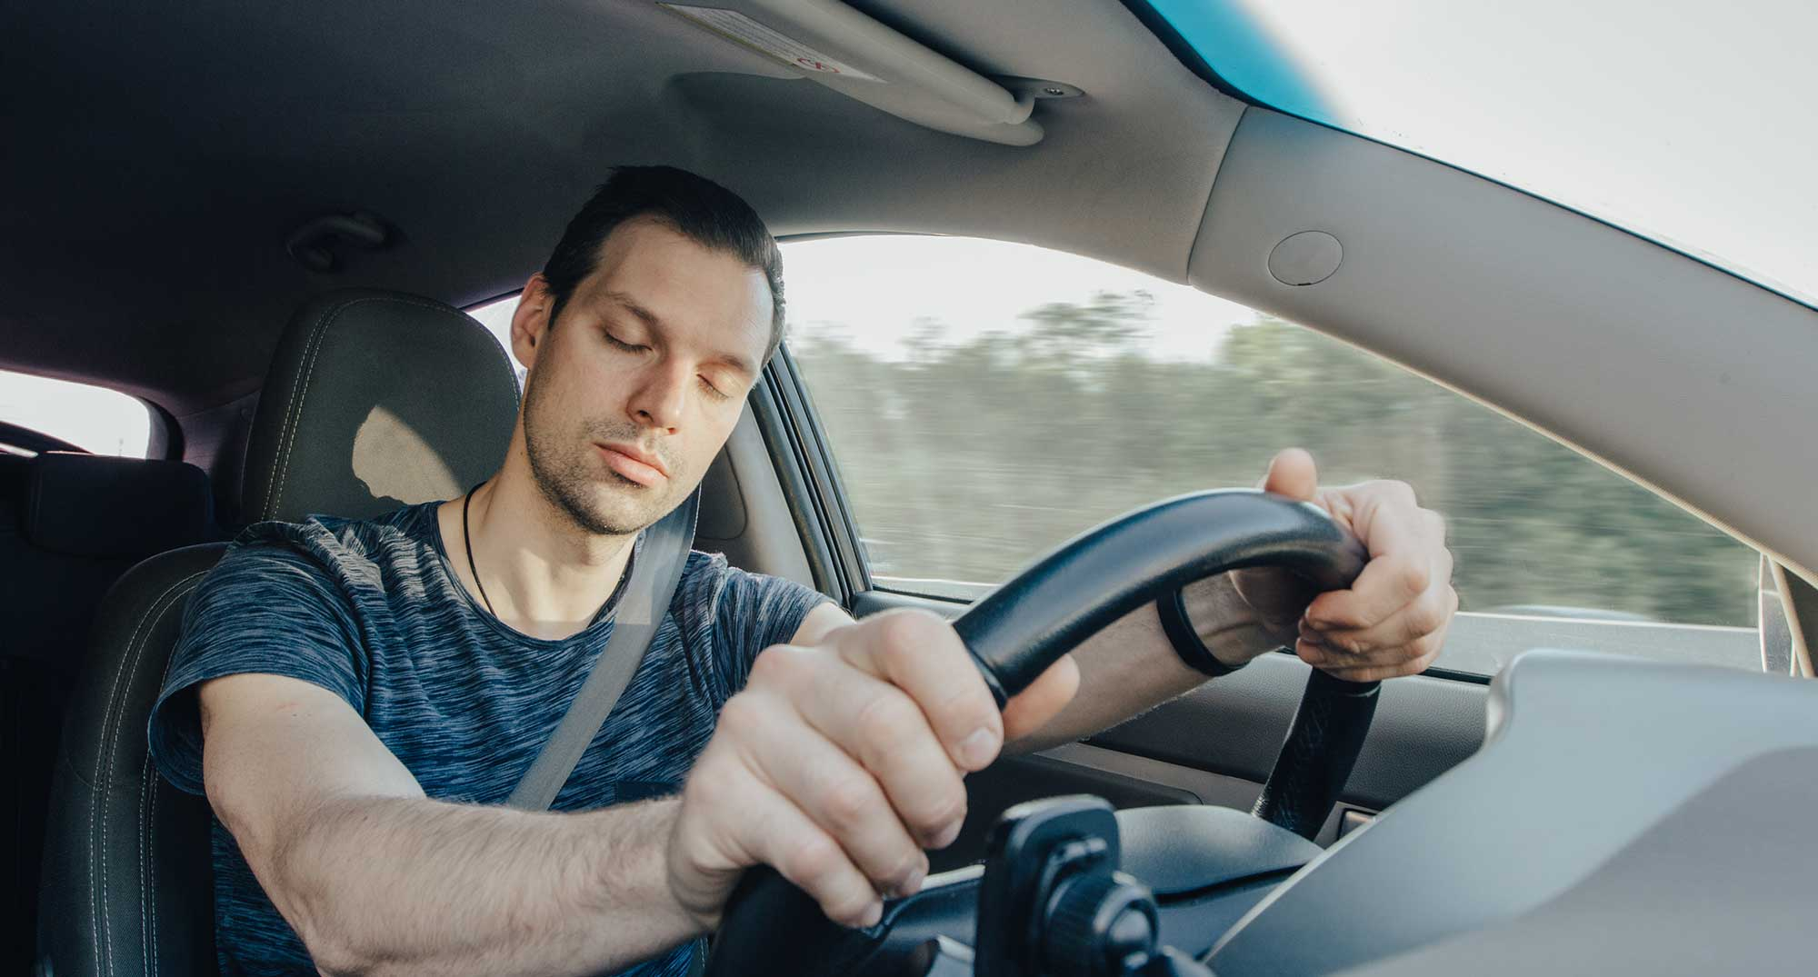

Driver Drowsiness Detection System
By: Dhruv Agarwal | Yash Khilavdiya |
Shubham Gurele

Slide 2
Agenda
Problem
Explanation
Solution
Proposed Methodology
Uniqueness
Current Progress

Slide 3
Problem
Driver Drowsiness
55,000 Accidents in Tamil Nadu
48,000 Accidents in Madhya Pradesh
Root Cause
Sleepiness
Source: Reasons for truck accidents citied by drivers India 2020 © Statista 2023
Published by Shangliao Sun (Mar 15, 2021)

Slide 4


Factors
Side Passenger
Music
Lighting
Visibility
Temperature

Slide 5
Emerging Solution
Machine Learning
Self Driving Cars

Slide 6

Approach

Slide 7

Uniqueness
Analysis of Side Passenger
Music Based Suggestion

Slide 8
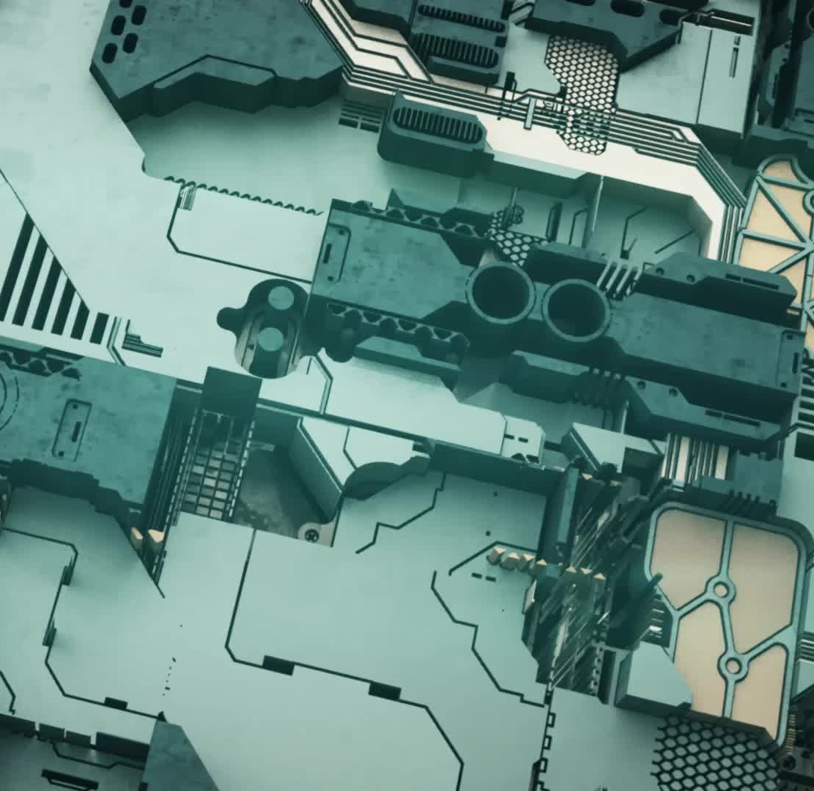
Future Scope
Hardware Setup
Temp Management

Slide 9

Current Progress

Slide 10
Any Questions?

